Slide 1


Chapter 3. FILE I/O : FURTHER DETAILS
Linux
January, 03, 2019
박재원 & 남호철
Dept. of Software
Dankook University
kevin405@naver.com
@gmail.com

Slide 2
Chapter Objectives
Extend the discussion of file I/O
Understand the concept of atomicity
Learn about fcntl() and one of its uses
Understand the kernel data structures used to represent
file descriptors and open files
Consider some system calls that provide extended read
and write functionality

Slide 3
Atomicity and Race Conditions (1/2)
What is Atomicity?
The kernel guarantees that a system call are completed as a single
operation
Essential to the successful completion of some operations
Allows us to avoid race conditions(=race hazard)
A race condition is a situation where the result produced by two processes (or threads) operating on shared resources depends in an unexpected way on the relative order in which the processes gain access to the CPU(s)

Slide 4
Atomicity and Race Conditions (2/2)
Eliminate race condition at file I/O
Creating a file exclusively
specifying O_EXCL in conjunction with O_CREAT
The check on the prior existence of the file and the creation of the file
are performed atomically
Appending data to file
opening a file with the O_APPEND flag
the seek to the next byte past the end of the file and the write operation happen atomically

Slide 5
fcntl() System call (1/2)
What is fcntl() system call?
range of control operations on an open file descriptor
#include <fcntl.h>
int fcntl(int fd, int cmd, ...)
cmd
F_GETFL
Retrieve or modify the access mode and open file status flags
F_SETFL
Modify some of the open file status flags
Flags that can be modified are O_APPEND, O_NONBLOCK, O_NOATIME, O_ASYNC, and O_DIRECT
Modify other flags are ignored
…
return value
depends on cmd
–1 on error

Slide 6
fcntl() System call (2/2)
When do we use fcntl() to modify open file status flags
The file was not opened by the calling program, so that it had no
control over the flags used in the open()
The file descriptor was obtained from a system call other than
open()

Slide 7
File Descriptors and Open Files (1/4)
What does the kernel maintain
Three data structures
The per-process file descriptor table
The system-wide table of open file descriptions
The file system i-node table
Table of open file descriptors records information about a
single file descriptor
System-wide table of all open file descriptions which stores all
information relating to an open file

Slide 8
File Descriptors and Open Files (2/4)
What does the i-node maintain
file type and permissions
a pointer to a list of locks held on this file
various properties of the file, including its size and timestamps
relating to different types of file operations

Slide 9
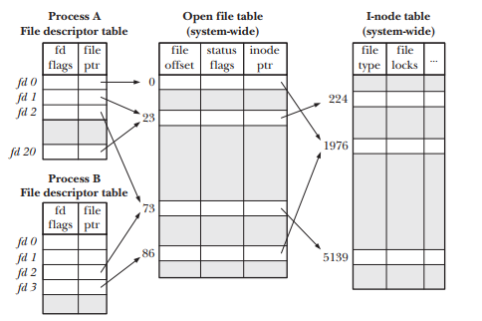
File Descriptors and Open Files (3/4)
relationship between file descriptors, open file descriptions,
and i-nodes
refer to the same open file
description (23) → dup(),
dup2(), or fcntl()
refer to a single open
→ fork() or using domain socket
file description (73)
refer to different open file
descriptions, refer to the same i-node table entry
→ independently called open()
for the same file

Slide 10
File Descriptors and Open Files (4/4)
File offset value
Can be shared by
Two different file descriptors that refer to the same open file description
Retrieving and changing the open file status flags using the fcntl() F_GETFL
and F_SETFL operations
File descriptor flags
private to the process and file descriptor

Slide 11
Duplicating File Descriptors (1/2)
Duplicating File Descriptors
#include <unistd.h> int dup(int oldfd);
oldfd : duplicated fd
return value
File descriptor
–1 on error
int dup2(int oldfd, int newfd);
oldfd : duplicated fd
newfd : duplicating fd
return value
File descriptor
–1 on error

Slide 12
Duplicating File Descriptors (2/2)
Duplicating File Descriptors
fcntl(oldfd, F_DUPFD, startfd)
duplicate of oldfd by using the lowest unused file descriptor greater than or equal to startfd
#include <unistd.h>
int dup3(int oldfd, int newfd, int flags);
oldfd : duplicated fd
newfd : duplicating fd
Flags
O_CLOEXEC
causes the kernel to enable the close-on-exec flag
return value
File descriptor
–1 on error

Slide 13
pread() & pwrite (1/2)
Duplicating File Descriptors
#include <unistd.h> ssize_t pread(int fd, void *buf, size_t count, off_t offset);
return value
number of bytes read
EOF
–1 on error
ssize_t pwrite(int fd, const void *buf, size_t count, off_t offset);
return value
number of bytes written
–1 on error

Slide 14
pread() & pwrite (2/2)
Feature of pread() & pwrite()
File I/O is performed at the location specified by offset
File offset is left unchanged by these calls
Useful in multithreaded applications and multiple processes
multiple threads can simultaneously perform I/O on the same file descriptor

Slide 15
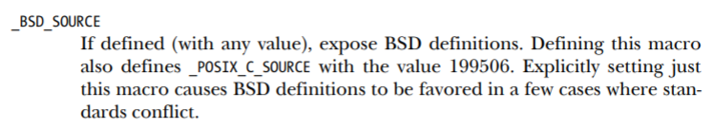
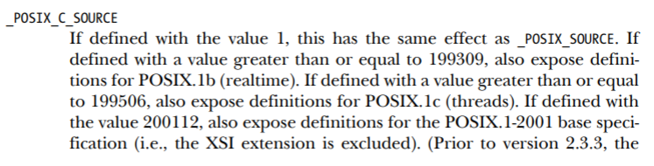
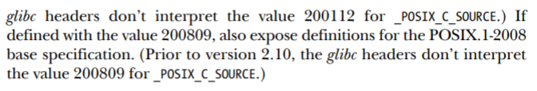
Portability issues (1/5)
Feature Test Macros
Various standards govern the behavior of the system call and library funtion APIs
Define the macro before including any header files(#include)
-> #define _BSD_SOURCE 1
Use the –D option to the C compiler
-> $ cc –D _BSD_SOURCE prog.c

Slide 16
Portability issues (2/5)
System data types
Various implementation data types(process IDs, user IDs, and file offsets) are represented using standard C types
C types such as int and long, reduce portability across UNIX system
The size of these fundamental types vary across UNIX implementations, or even in different compilation environments on the same implementation
Even on a single UNIX implementation, the types used to represent information may differ between releases(version) of the implementation
Standard system data types (by SUSv3)
It is defined using the C typedef feature
-> typedef int pid_t;
Most of these data types have names ending in _t
-> pid_t mypid;

Slide 17
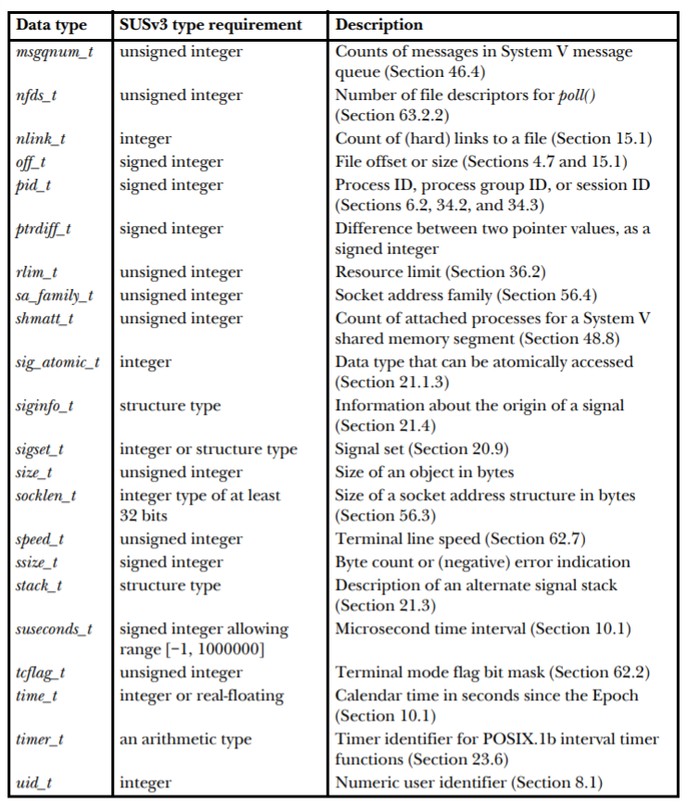
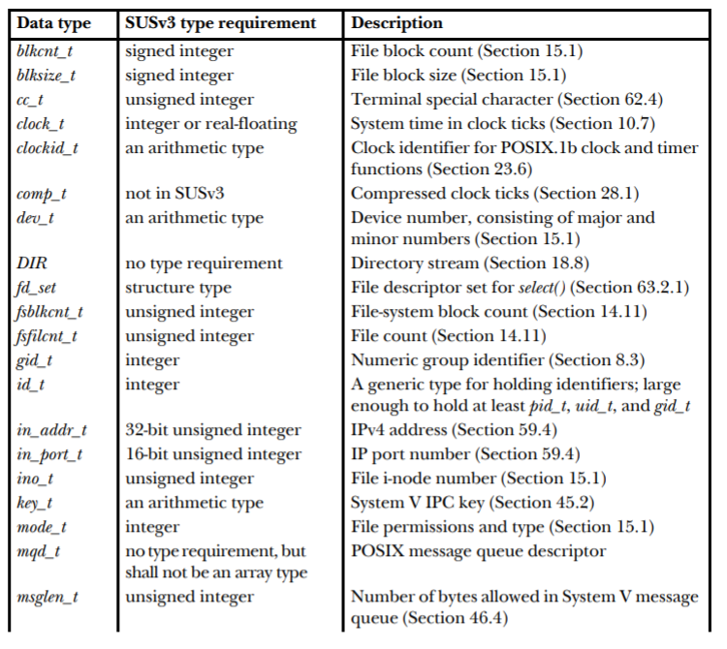
Portability issues (3/5)
System data types

Slide 18

Portability issues (4/5)
System data types
Printing system data type values
When printing values of one of the numeric system data types(pid_t and uid_t)
be careful not to include a representation dependency in the printf() call
use the %ld specifier and cast the corresponding value to long

Slide 19
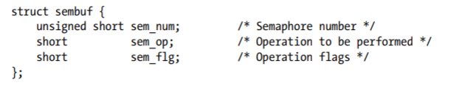
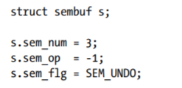
Portability issues (5/5)
Miscellaneous portability issues
Initializing and using structures
the order of field definitions within such structures is not specified
extra implementation-specific fields may be included
Portable initializing
Use explicit assignment statement

Slide 20
Thank you
Linux

